Slide 1
Glass Processing

Slide 2
Glass – An Introduction
Glass is an inorganic product of fusion that has cooled to rigid condition without crystalizing
When glass is cooled from the hot molten state, it gradually increases in viscosity without crystallization over a wide temperature range until it assumes its characteristic hard, brittle form. Cooling is controlled to prevent crystallization, or high strain.
Glass is, actually more like a liquid, but at room temperature it is so viscous or sticky it looks and feel like solid. At higher temperature the glass become softer and more like a liquid. It is this later property which allows glass to be poured, blown, pressed and molded into such a variety of shapes.

Slide 3
History
Until the 16th century, window glass or other flat glass was generally cut from large discs (or rondels) of crown glass. Larger sheets of glass were made by blowing large cylinders which were cut open and flattened, then cut into panes. Most window glass in the early 19th century was made using the cylinder method. The 'cylinders' were 6 to 8 feet (180 to 240 cm) long and 10 to 14 inches (25 to 36 cm) in diameter, limiting the width that panes of glass could be cut, and resulting in windows divided by transoms into rectangular panels.
Before the development of float glass, larger sheets of plate glass were made by casting a large puddle of glass on an iron surface, and then polishing both sides, a costly process. From the early 1920s, a continuous ribbon of plate glass was passed through a lengthy series of inline grinders and polishers, reducing glass losses and cost
Glass of lower quality, drawn glass, was made by drawing upwards from a pool of molten glass a thin sheet, held at the edges by rollers. As it cooled the rising sheet stiffened and could then be cut. The two surfaces were of lower quality i.e. not as smooth or uniform as those of float glass. This process continued in use for many years after the development of float glass.

Slide 4
Advances in architectural glass
1226: "Broad Sheet" first produced in Sussex
1330: "Crown glass" for art work and vessels first produced in Rouen, France. "Broad Sheet" also produced. Both were also supplied for export.
1500s: A method of making mirrors out of plate glass was developed by Venetian glassmakers on the island of Murano, who covered the back of the glass with a mercury-tin amalgam, obtaining near-perfect and undistorted reflection.
1620s: "Blown plate" first produced in London. Used for mirrors and coach plates.
1678: "Crown glass" first produced in London. This process dominated until the 19th century.
1843: An early form of "float glass" invented by Henry Bessemer, pouring glass onto liquid tin. Expensive and not a commercial success.
1874: Tempered glass is developed by Francois Barthelemy Alfred Royer de la Bastie (1830–1901) of Paris, France by quenching almost molten glass in a heated bath of oil or grease.
1888: Machine-rolled glass introduced, allowing patterns.
1898: Wired-cast glass first commercially produced by Pilkington for use where safety or security was an issue.
1959: Float glass launched in UK. Invented by Sir Alastair Pilkington

Slide 5
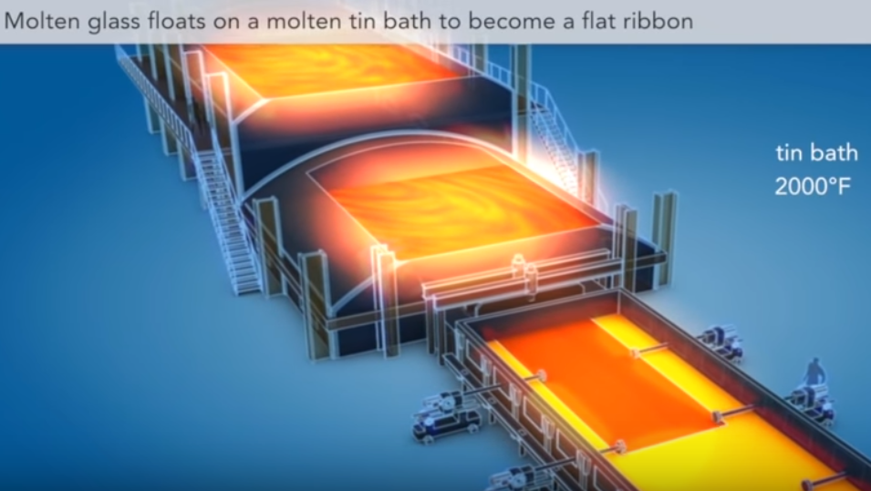
Float Glass
Float Glass is a sheet of glass made by floating molten glass on a bed of molten metal, typically “tin”. This method gives the sheet uniform thickness and very flat surfaces. The float glass process is also known as ‘Pilkington Process’ named after British glass manufacturer Pilkington, which pioneered the technique in 1950’s.
https://youtu.be/JMGkbrETU8M

Slide 6
Glass Manufacturing – 1/2
Glass-making raw materials typically consisting of sand, soda ash (sodium carbonate), dolomite, limestone, and salt cake (sodium sulphate) etc. Other materials may be used as colorants, refining agents or to adjust the physical and chemical properties of the glass.
The raw materials are mixed in a batch process, then fed together with suitable cullet (waste glass), in a controlled ratio, into a furnace where it is heated to approximately 1500 °C. Common float glass furnaces are 9 m wide, 45 m long, and contain more than 1200 tons of glass. Once molten, the temperature of the glass is stabilised to approximately 1200 °C to ensure a homogeneous specific gravity.
The molten glass is fed into a "tin bath", a bath of molten tin (about 3–4 m wide, 50 m long, 6 cm deep), from a delivery canal and is poured into the tin bath by a ceramic lip known as the spout lip.[9] The amount of glass allowed to pour onto the molten tin is controlled by a gate called a tweel.
Tin is suitable for the float glass process because it has a high specific gravity, is cohesive, and is immiscible with molten glass. Tin, however, oxidises in a natural atmosphere to form tin dioxide (SnO2). Known in the production process as dross, the tin dioxide adheres to the glass.

Slide 7
Glass Manufacturing – 2/2
To prevent oxidation, the tin bath is provided with a positive pressure protective atmosphere of nitrogen and hydrogen
The glass flows onto the tin surface forming a floating ribbon with perfectly smooth surfaces on both sides and of even thickness. As the glass flows along the tin bath, the temperature is gradually reduced from 1100 °C until at approximately 600 °C the sheet can be lifted from the tin onto rollers.
The glass ribbon is pulled off the bath by rollers at a controlled speed. Variation in the flow speed and roller speed enables glass sheets of varying thickness to be formed. Top rollers positioned above the molten tin may be used to control both the thickness and the width of the glass ribbon.
Once off the bath, the glass sheet passes through a lehr kiln for approximately 100 m, where it is cooled gradually so that it anneals without strain and does not crack from the temperature change. On exiting the "cold end" of the kiln, the glass is cut by machines.

Slide 8
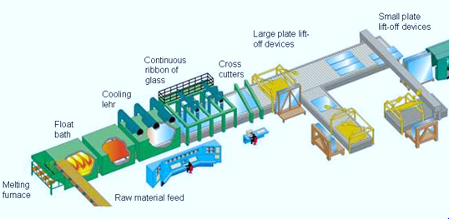
Float glass manufacturing
Silica Sand 51%
Soda Ash 16%
Dolomite 13%
Lime stone 4%
Sodium
Sulphate 1%
Crushed
glass 15%
Heat & Fire polishing zone
Controlled
Cooling zone
1500∘C
600∘C
200∘C
Molten tin
Melting furnace
Floating Zone
Cooling Zone

Slide 9
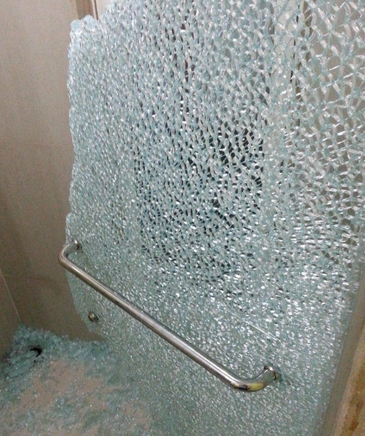
Tempered Glass
Float glass heated to a temperature near its softening point and forced to cool rapidly under controlled conditions is "Tempered glass" .The heat treatment technique increases the strength of annealed glass by four to five times
Benefits of Tempered Glasses
Strength : Tempered glass is approximately four times as strong as annealed glass and able to resist temperature differences (200 ° F - 300 ° F) which would cause annealed glass to crack
Safety : Fully tempered glass is used for its safety characteristics. Safety comes from strength and from a unique fracture pattern than regular glass. When tempered glass is struck it does not break in to sharp jagged pieces of shrapnel like glass. Instead it breaks in to little pebble-like pieces without sharp edges
Breakage of Tempeted Glass

Slide 10
Tempered glass manufacturing
Blank Preperation
washing & Drying
Heating
Bending
Forced cooling
450 - 650∘C
Inspection

Slide 11
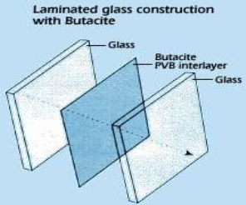
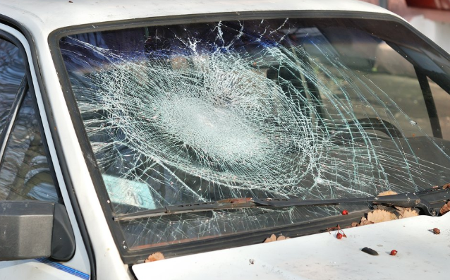
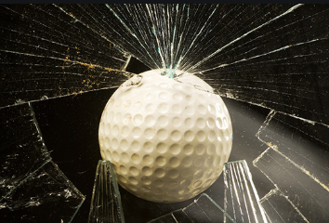
Laminated glass
Laminated glass is a sandwich of two sheets of glass bonded together with one or more special plastic interlayer like Poly-Vinyl-Butryl (PVB) in between, under heat and pressure to form a single piece
Benefits of Laminated Windshield
Safety and Security : Laminated glass cracks under impact, but typically remains integral, unlike annealed glass which typically produces long sharp-edged splinters on breakage
Acoustic Control : Highly effective in noise reduction
UV Rays Blockade : Prevents deterioration in the appearance of interior trims by blocking UV rays
Breakage of Laminated Glass
Breakage of Normal Glass

Slide 12
Laminated Glass - Windshield Manufacturing
Blank Preparation
Edge grinding
Washing & Drying
Laying PVB sheet & Trimming
Bending
Ceramic Printing & Baking
Deepak
Pathak VLM-13
Air removal
Final baking in Autoclave
Inspection & packing
Vacuum

Slide 13
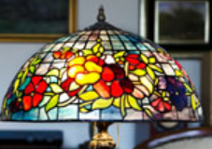
Coloured Glass
The recipe for producing coloured glass usually involves the addition of a metal to the glass. This is often accomplished by adding some powdered oxide, sulphide, or other compound of that metal to the glass while it is molten. The table below lists some of the colouring agents of glass and the colours that they produce. Manganese dioxide and sodium nitrate are also listed. They are decolouring agents - materials that neutralize the colouring impact of impurities in the glass.
Red, a very important colour for use in a stained glass window, was especially vulnerable to fading. Artists in many countries worked to produce a red glass that would hold its colour through the years under the direct sunlight that passed through the windows. Eventually a permanent red colour was developed by adding small amounts of gold to the glass. This significantly increased the cost of the glass, but the red colour was achieved. Even today, if you purchase a red sheet of glass it will cost significantly more than any other colour.
Metals Used to Impart Colour to Glass
Cadmium Sulphide | Yellow
Gold Chloride | Red
Cobalt Oxide | Blue-Violet
Manganese Dioxide | Purple
Nickel Oxide | Violet
Sulphur | Yellow-Amber
Chromic Oxide | Emerald Green
Uranium Oxide | Fluorescent Yellow, Green
Iron Oxide | Greens and Browns
Selenium Oxide | Reds
Carbon Oxides | Amber-Brown
Antimony Oxides | White
Copper Compounds | Blue, Green, Red
Tin Compounds | White
Lead Compounds | Yellow
Manganese Dioxide | A "decolouring" agent
Sodium Nitrate | A "decolouring" agent

Slide 14
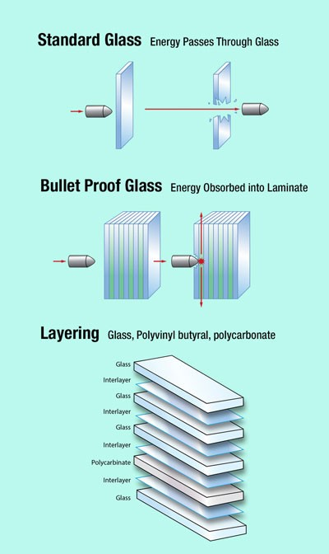
Bullet-resistant glass (ballistic glass)
Bullet Proof glass is a strong and optically transparent material that is particularly resistant to penetration by projectiles - it is not completely impenetrable
Bullet-resistant glass is constructed using layers of laminated glass. The more layers there are, the more protection the glass offer
Laminated glass layers are built from glass sheets bonded together with Poly-Vinyl Butyral, polyurethane, Sentryglas or ethylene-vinyl acetate. When treated with chemical processes, the glass becomes much stronger. This design has been in regular use on combat vehicles since World War II. It is typically thick and is usually extremely heavy
Bulletproof glass varies in thickness from 3⁄4 to 3 1⁄2 inches (19 to 89 mm)

Slide 15
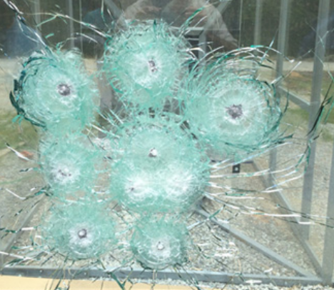
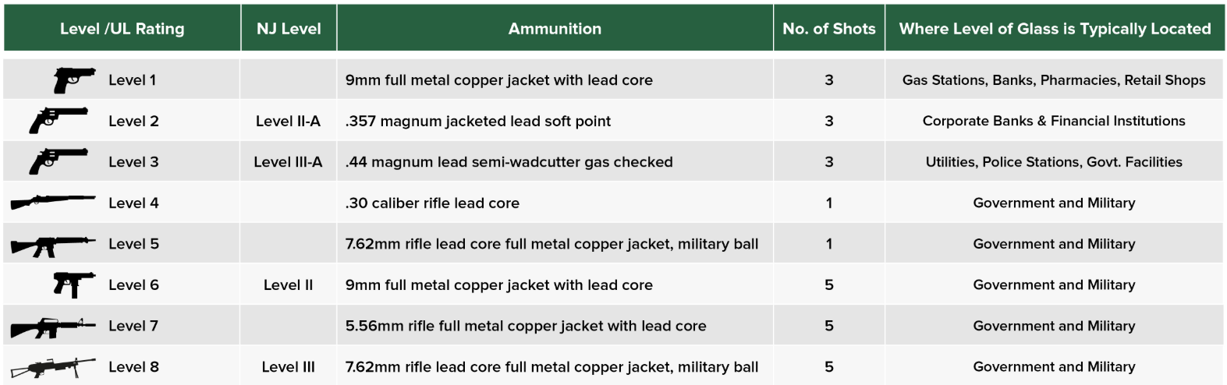
8 Levels of Bullet-Resistant Glass

Slide 16
Application of Glass
Glass is used in the following non-exhaustive list of products:
Packaging (jars for food, bottles for drinks, flacon for cosmetics and pharmaceuticals)
Tableware (drinking glasses, plate, cups, bowls)
Housing and buildings (windows, facades, conservatory, insulation, reinforcement structures)
Interior design and furniture (mirrors, partitions, balustrades, tables, shelves, lighting)
Appliances and Electronics (oven doors, cook top, TV, computer screens, smart-phones)
Automotive and transport (windscreens, backlights, light weight but reinforced structural components of cars, aircrafts, ships, etc.)
Medical technology, biotechnology, life science engineering, optical glass
Radiation protection from X-Rays (radiology) and gamma-rays (nuclear)
Fibre optic cables (phones, TV, computer: to carry information)
Renewable energy (solar-energy glass, wind turbines)
All of this is made possible by the countless properties of the glass substance

Slide 17
The future of glass
The outcome of research in all different fields could open up tremendous opportunities for the development of future glass products and the way we currently use glass in various applications. Just imagine:
Smart glass bottles and containers whose colour changes depending on the liquid temperature (medicines, wines, perishable products, etc.)
Interactive drinking glass
Photovoltaic sunroof to provide electricity to hybrid and electric vehicles
LED light sources in jewellery
Mirrors assessing the health condition of the person standing in front of it
Jewellery assessing the cardiac rhythm and body temperature
More complex glass shapes and further improved insulation properties to free architects from constraints
Smaller and best performing photovoltaic and wind energy electricity generation equipment whose integration would become easier to fulfil most of Europe’s energy needs.

